Slide 1
Panel Debate 1
Scaling up Digital Health

Slide 2
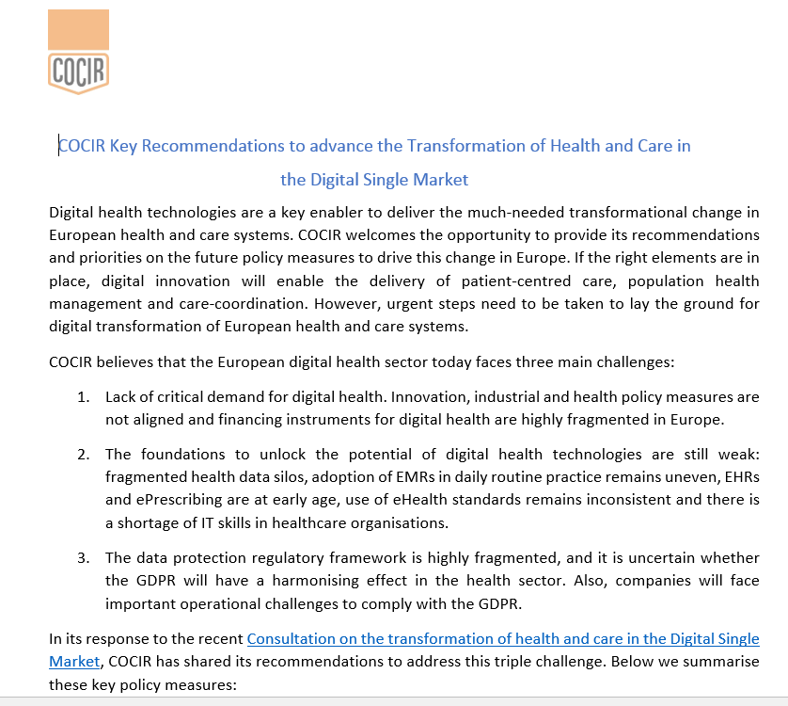
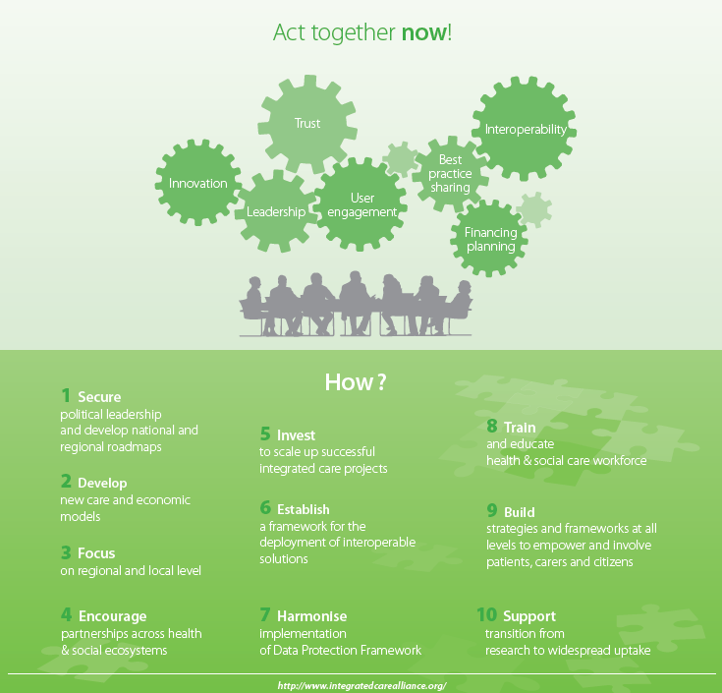
COCIR Relevant Activities
COCIR response to the Consultation on the transformation of Health and Care in the Digital Single Market, Oct 2017
Integrated Care Alliance launched in June 2016. www.integratedcarealliance.org

Slide 3
Speakers
Bart Vermeulen, Deputy Director Healthcare - ‎Office of the Belgian Minister of Social Affairs and Public Health
Maddalena Illario, Representative of the Campania Region, Reference Sites Collaborative Network and Researcher at University of Naples Federico II
Nick Goodwin, CEO, International Foundation for Integrated Care
Kevin Massoudi, COCIR Lead member in Digital Health and Product Manager Oncology Information Systems EMEIA at Varian Medical Systems

Slide 4
Questions for Discussion (1/2)
How do we ensure the scale and sustainability of digital health initiatives/programs and accelerate the change?
What specific measures can be taken by the European Commission, Member States, Healthcare providers and Industry to strengthen the foundations of a European digital health ecosystem and ensure that digital health can support health systems strategies?
To what extent are good practices transferable? Are there any areas (governance, financing, IT, business models, care delivery models, incentive schemes…) where good practices can be more easily transferred?

Slide 5
Questions for Discussion (2/2)
Can Europe remain Big on Health?
Will Member states use the European space for more systematic cross-learning and peer review?
How to accelerate the big data revolution as a tool for systems reform and management?
How can we ensure that the European initiatives are bringing value at country and regional level?

